Slide 1

Department of Information Technology
NBA Accredited A.P. Shah Institute of Technology G.B.Road, Kasarvadavli, Thane(W), Mumbai-400615 UNIVERSITY OF MUMBAI Academic Year 2022-2023

Slide 2
A Project Report on Go-Brainous: An AI based Educational App for Kids Submitted in partial fulfillment of the degree of Bachelor of Engineering(Sem-8)
in INFORMATION TECHNOLOGY By
Bhimraj Parihar (19104004) Siddharth Chhoriya (20204005)
Under the Guidance of Prof. Roshna Sangle

Slide 3
1.Project Conception and Initiation

Slide 4
1.1 Abstract
Preschool years are critical for a child's development.
Educational games can help meet children's educational demands in today's busy world.
When using educational games for online learning, the game design and educational objectives should be balanced.
The role of educational games in e-learning is significant.
Game design facets should be considered in creating effective educational games.
Categorizing educational games based on their educational purposes is essential.
The relationship between educational objectives and game design is crucial in creating an engaging educational game.

Slide 5
1.2 Objectives
We intend to do this project implementation to meet the following objectives:
To develop an app with instructional games using Tensor flow Lite Model.
To create games and creative activities such as numbering, alphabet, alphabet training, math quiz, fruits, animals, vegetables, drawing books, vehicles, shapes, colors, days, months and body parts should be developed in order to avoid burnout.
To include a feature like curriculum integration within the app.
To develop an app that would assist students in concentrating on their academics.

Slide 6
1.3 Literature Review
Serial No. | Paper Name | Author Name | Key Findings
1. | A Study of Early Childhood E-Learning Games for Thai Children | Veeraporn Siddoo, Dainah Binla, Kanokwan Jaineawnaekuson, Orapan Yommana | This paper presents a prototype for e-learning games as well as the appropriate e-learning games for pre-schoolers. The discovery creates an alternative to learning games by examining professional advice given during game development.
2. | A Custom and Dynamic Game using Gamification Techniques to Children from 4 to 5 years old. | Renato Toasa, Esteban Burbano, Alexandra Constante, Lesly Hidalgo, Flavio Morales | The concept for developing various mobile games that could help children in learning the alphabet, numbers, and other subjects in the early stages of their education is described in this paper.

Slide 7
1.4 Problem Definition
Go-Brainous aims to develop an app for kids.
The app will include quiz, games, and creative activities such as numbering, alphabet, alphabet training, math quiz, fruits, animals, vegetables, drawing books, vehicles, shapes, colors, days, months, and body parts.
The app will use Tensor Flow lite Model for Alphabet Training.
Java and XML will be used to develop the app, with XML used for creating a layout.
The app's goal is to provide an easy and interesting way of learning for kids.

Slide 8
1.5 Scope
The app can provide an interactive learning experience for preschoolers.
It can make learning basic concepts such as numbers, letters, shapes, and colors more engaging and fun.
The quiz, games, and creative activities in the app can help keep kids interested and motivated.
Making the app compatible with Android platform can ensure a wider reach for the app.
The app can help promote early childhood education and provide kids with essential skills for their future academic and personal development.

Slide 9
1.6 Technology stack
Tensor flow Lite
Java
Xml

Slide 10
1.7 Benefits for environment & Society
The app promotes early childhood education, which can lead to a better-educated society in the future.
By providing an easy and interesting way of learning, the app can help reduce the educational gap among children.
The app can be used by children all around the world, promoting a more accessible and inclusive learning environment.
Overall, the app can have a positive impact on society by promoting education and inclusivity.

Slide 11
2. Project Design

Slide 12
2.1 Proposed System
The system will be an educational gaming application designed for students between the ages of 3 and 7 years.
The system will incorporate game-based elements to promote active learning and problem-solving skills.
The application will feature a variety of games and activities that satisfy both fun and educational objectives.
The application will include assessment tools such as math quizzes to help students evaluate their learning and identify areas where they may need additional support.
The system will be designed to be user-friendly and easy to navigate for both children and parents.
The system will be designed to be compatible with Android platform can ensure a wider reach.

Slide 13
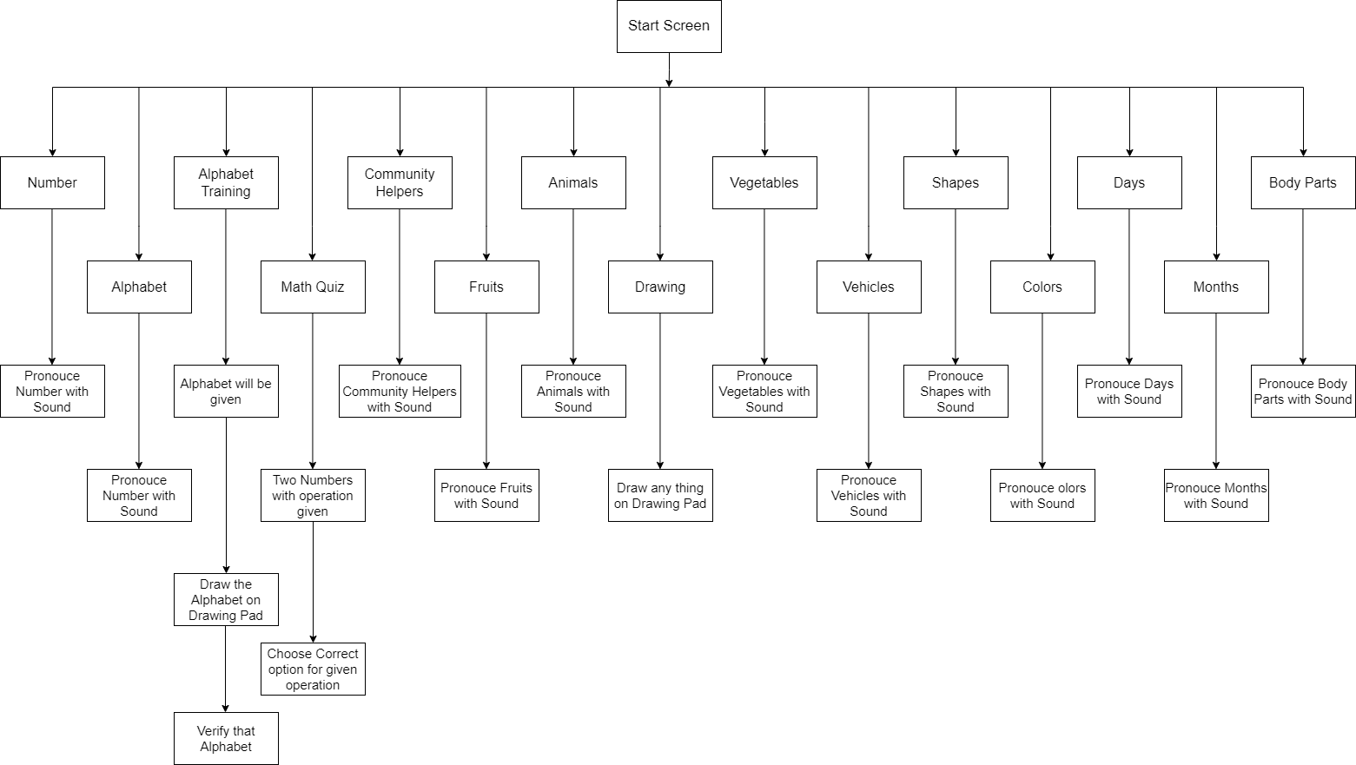
2.1 Proposed System

Slide 14
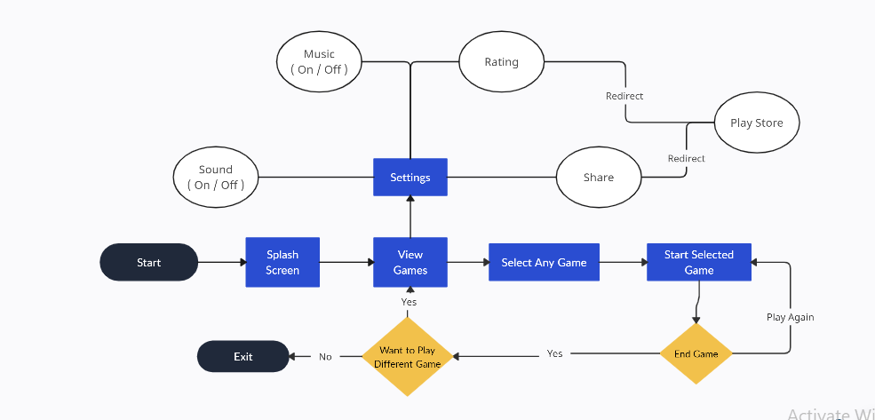
2.2 Design(Flow Of Modules)

Slide 15
2.3 Description Of Use Case
The use-case diagram describes the high-level functions and scope of the system, as well as the interactions between the system and its actors.
The actor in this use case diagram is the user, who interacts with the system to select and play different games.
The splash screen will appear first, followed by the main dashboard where the user can select a game from a list of different games.
The user has two options to start playing the game: they can learn how to play through a guide, or they can directly start the game.
Once the game is over, the user has two options to play the game again or go back to the home page, which can redirect them to the game page, or they can exit from the game.
If the user wants to play a different game, they can follow the same process for that game.
The user also has the option to go forward to the next level of the game after finishing the current level.

Slide 16
2.3 Description Of Use Case

Slide 17
3. Implementation

Slide 18
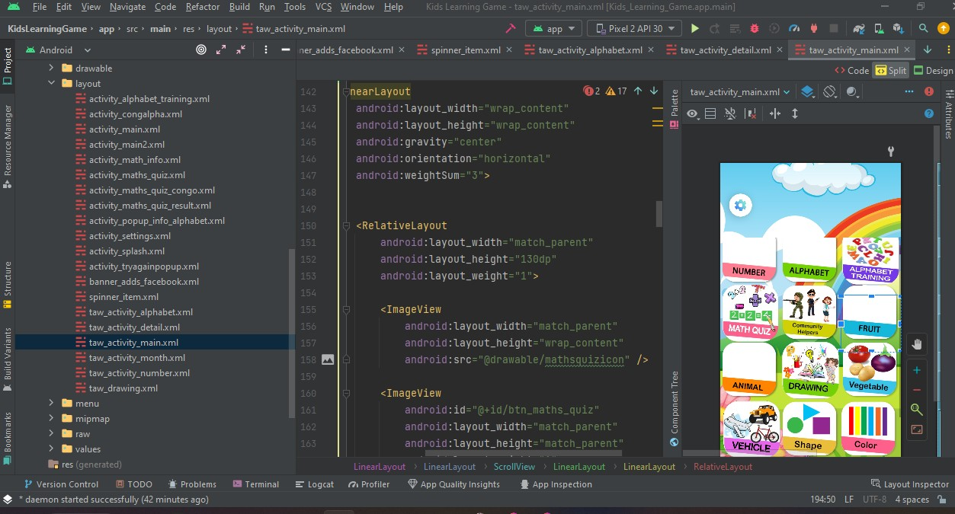
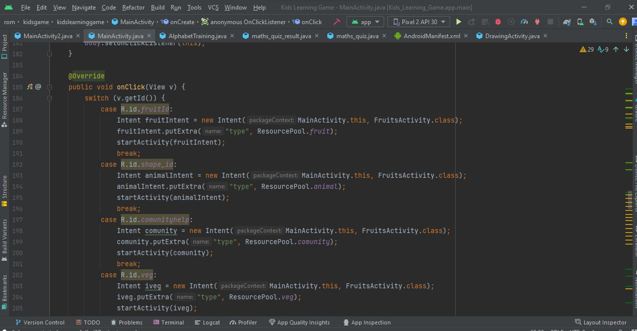

Slide 19
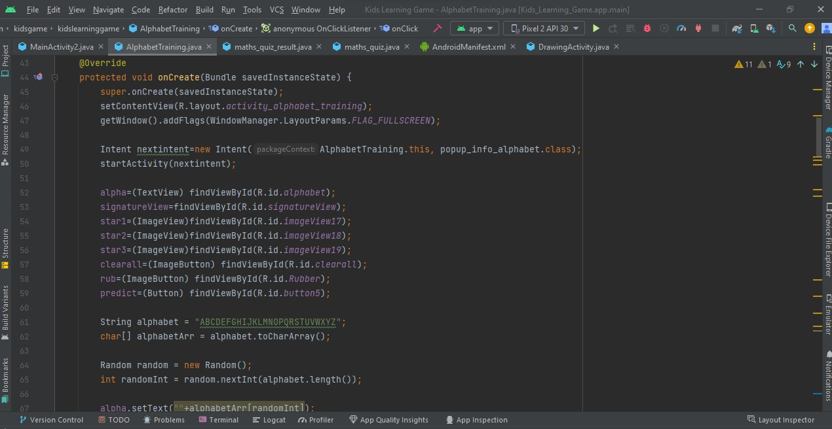
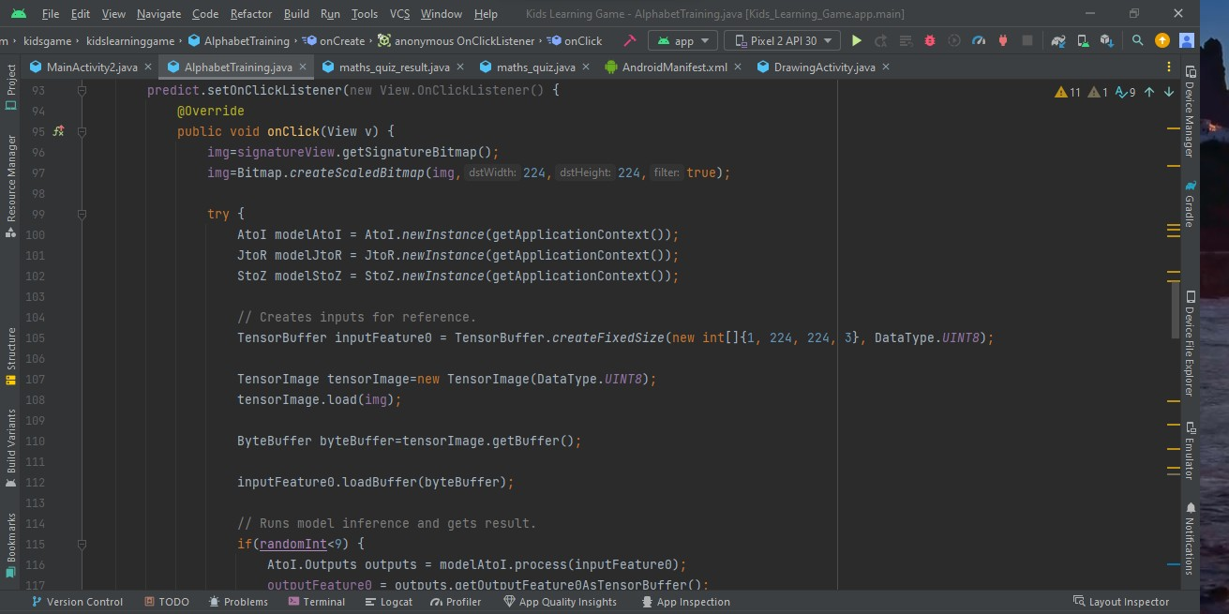

Slide 20
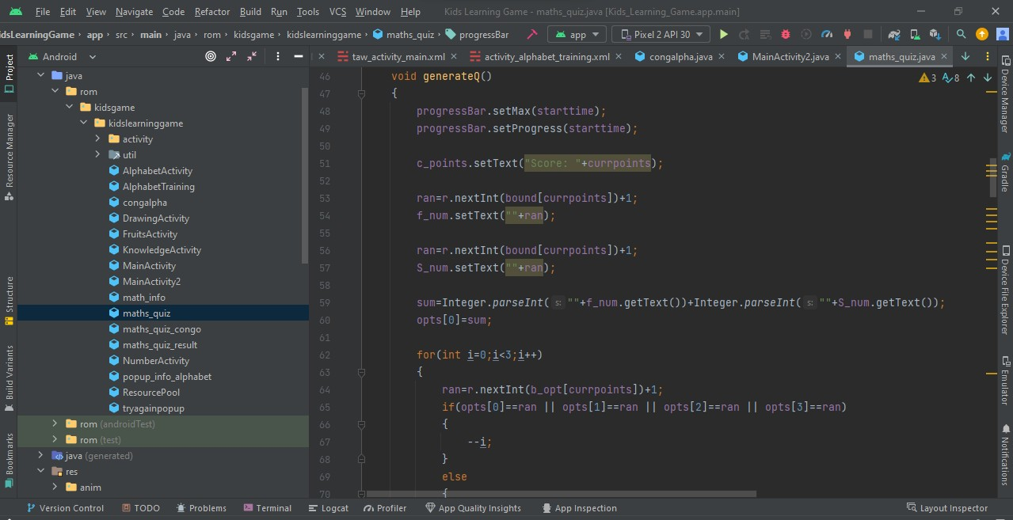
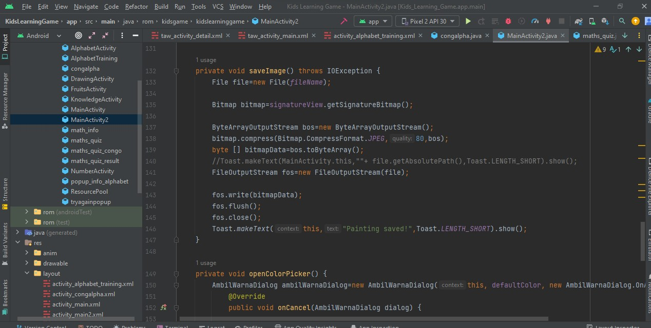

Slide 21
4. Testing

Slide 22
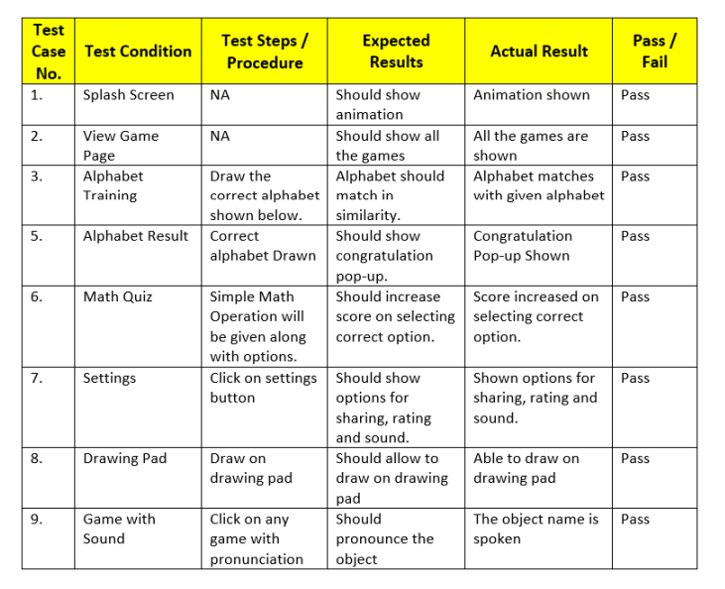

Slide 23
5. Result

Slide 24
The Go-Brainous application has been successfully created, providing a fun and engaging way for kids to learn and improve their cognitive skills.
The positive feedback from the user testing phase has further validated the effectiveness and usability of the application.
Overall, the development of Go-Brainous has provided a fun and engaging way for children to learn and has the potential to positively impact their educational development.

Slide 25
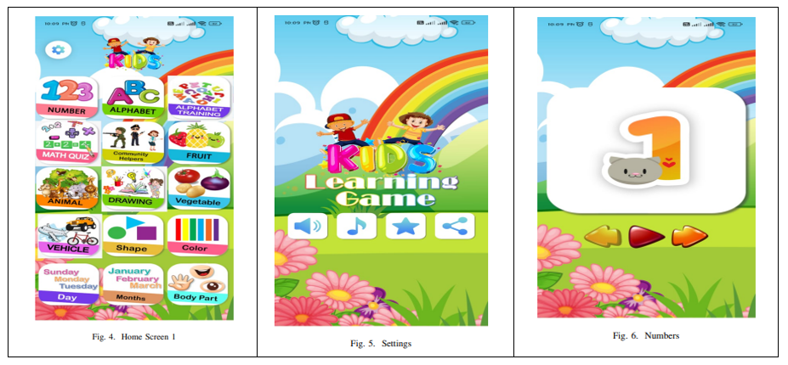

Slide 26
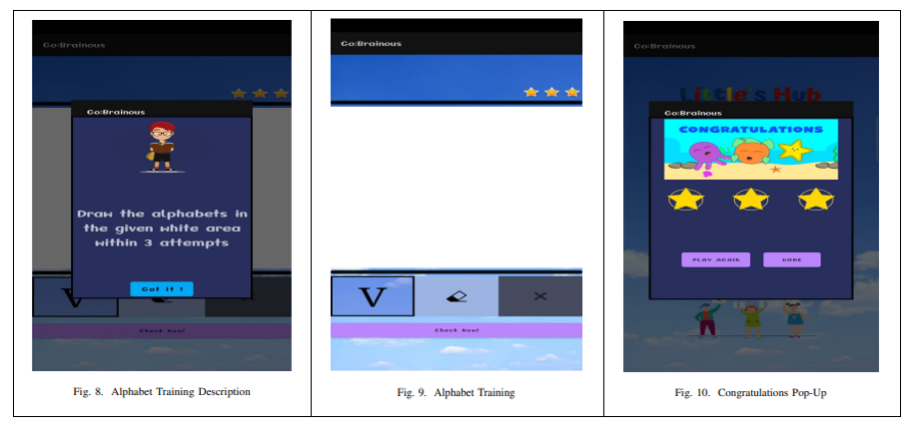

Slide 27
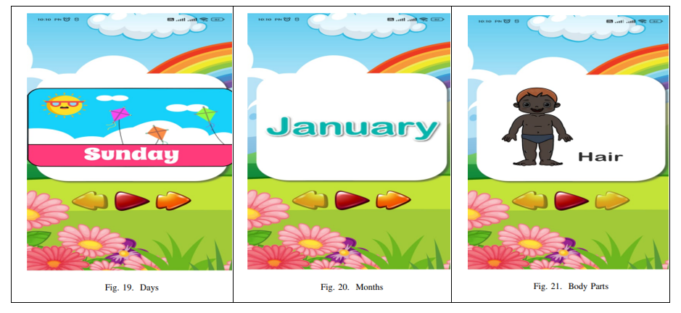

Slide 28
6. Conclusion and Future Scope

Slide 29
The Go-Brainous game has been developed for kids in which quizzes and games are included like numbering, alphabet, alphabet training, math quiz, fruits, animals, vegetables, drawing books, vehicles, shapes, colours, days, months and body parts.
The application is developed using the TensorFlow lite Model. The proposed system is developed on Java and XML where XML is used for creating a layout.
This project is successfully became an educational application through which students develop a variety of connections with the content and can form positive memories of learning as games to grab the students’ attention and actively engage them.
The project includes several enhancements that can further improve the user experience of the application such as to add more games to the application, providing users with a wider variety of options to choose from.
The application can be published on the Play store, which will enable a wider audience to access the application. We can also take feedback and provide suggestions or report any issues they face while using the application.

Slide 30
References
V. Siddoo, D. Binla, K. Jaineawnaekuson and O. Yommana, ”A study of early childhood e-learning games for Thai children,” 2016 Fifth ICT International Student Project Conference (ICT-ISPC), 2016, pp. 29-32, doi: 10.1109/ICT-ISPC.2016.7519228.
A. A. Yunanto, D. Herumurti, I. Kuswadayan, R. R. Hariadi and S. Rochimah, ”Design and Implementation of Educational Game to Improve Arithmetic Abilities for Children,” 2019 12th International Conference on Information and Communication Technology and System (ICTS), 2019, pp. 27-31, doi: 10.1109/ICTS.2019.8850966.
R. Toasa, E. Burbano, A. Constante, L. Hidalgo and F. Morales, ”A Custom and Dynamic Game using Gamification Techniques to Children from 4 to 5 years old,” 2019 14th Iberian Conference on Information Systems and Technologies (CISTI), 2019, pp. 1-5, doi: 10.23919/CISTI.2019.8760593.
A. Dinimaharawati, A. I. Wuryandari and H. A. Aziiz, ”Designing Educational Games on E-learning SMANAS Based Learning Experience Design,” 2018 International Seminar on Research of Information Technology and Intelligent Systems (ISRITI), 2018, pp. 265-270, doi: 10.1109/ISRITI.2018.8864470.

Slide 31
Paper Publication
Paper entitled “Go-Brainous: An AI based Educational App for Kids” is presented at “11th International Conference on Emerging Trends in Engineering Technology - Signal and Information Processing (ICETET - SIP) ” by “Bhimraj Parihar” and “Siddharth Chhoriya”.

Slide 32
Thank You

